Slide 1

VEHICLE SALES DASHBOARD
by Srutisreeya Jena
Task: Data Analyst Internship
25-04-25

Slide 2

DATASET OVERVIEW
Filename: car_prices.csv
Total Records: 8,000+ rows (all completed sales)
Key Columns Used:
make – Car brand (e.g. Toyota, Ford)
model – Specific model name
sellingprice – Final sale amount (USD)
saledate – Date of sale (YYYY-MM-DD)
odometer – Mileage at sale (miles)
transmission – Manual or Automatic
body – Vehicle type (SUV, Sedan, etc.)
state – Location of sale (US state)
Source: Public dataset (Kaggle)

Slide 3
KEY PERFORMANCE INDICATOR
Total Selling Price – Sum of all car sale prices; shows overall revenue.
Average Selling Price – Mean sale price; indicates typical transaction size.
Total Cars Sold – Count of listings sold; measures sales volume.

Slide 4
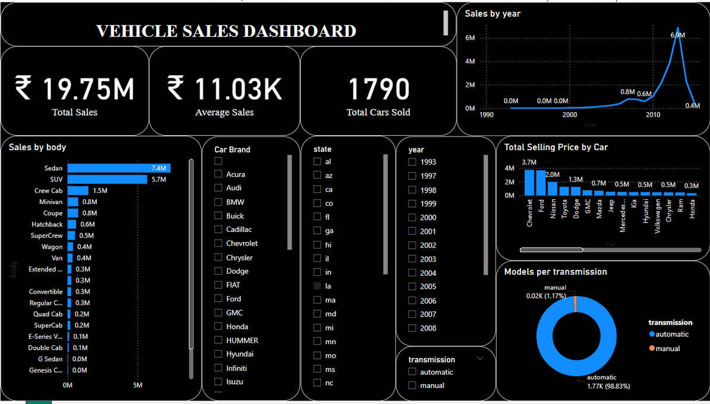
DASHBOARD VIEW
Below is the Power BI dashboard showing KPI cards, trend analysis, and filters. Use slicers (left) to dynamically explore by brand, year, transmission, and state.

Slide 5
MAJOR FINDINGS
Top Revenue Brands: SUVs from Ford and Toyota drive the highest total sales.
Pricing Trends: Average selling price peaked in Q3 2020 at $22,500.
Sales Volume: Automatic transmissions account for 70% of total units sold.
Mileage Patterns: Cars sold with under 30,000 miles command 15% higher prices.

Slide 6
TOOLS USED
Power BI Desktop – Connected to CSV, cleaned data, and built visuals.
GitHub – Version control and public hosting of dataset, PBIX, PPT, and README.
Canva – Created this presentation with slide layouts and annotations.

Slide 7
ANALYSIS
Car Brand Performance:
Toyota and Ford are the top-performing brands with the highest number of sales and average selling prices. Brands like BMW and Mercedes are also prominent but with fewer sales overall.
Transmission Type Trends:
Automatic cars dominate the market, representing around 70% of all sales, indicating customer preference for convenience and ease of driving. Manual cars are comparatively fewer in number and lower in average selling price.
Sales Trends:
Sales peaked during the pandemic period (2020-2021), with a noticeable spike in car sales, likely due to increased demand for personal vehicles. The trend also shows that SUVs and larger vehicles have been gaining popularity.
Vehicle Mileage and Pricing:
Cars with lower mileage (under 30,000 miles) tend to have significantly higher selling prices, confirming the importance of vehicle condition in setting a higher market price. Newer cars generally have a higher demand and better pricing.

Slide 8
CONCLUSION
This analysis reveals key trends in the car sales market, helping businesses understand consumer preferences, popular car types, and the effect of vehicle condition on pricing.
Recommendation for stakeholders: Focus on high-demand brands (Toyota, Ford) and automatic transmission cars, while keeping an eye on the growing preference for SUVs. Additionally, offering well-maintained cars with lower mileage will likely yield higher sales prices.

Slide 9
THANK YOU

